Slide 1
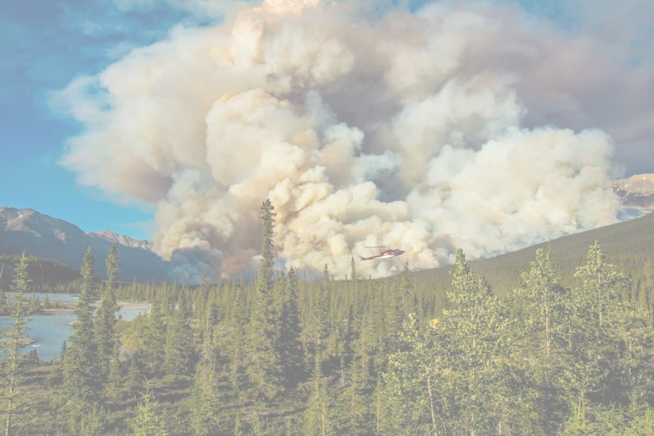
Biomass-based cellular automaton for exploring wildfire
By J Kahn and Helen Miller
QERM 497
March 7, 2023

Slide 2
Presentation Roadmap
Ecological Context
Model Description
Experiments + Results
Conclusions
Notes:
H – Ecological context + model description
J – Experiments and Results + conclusions

Slide 3
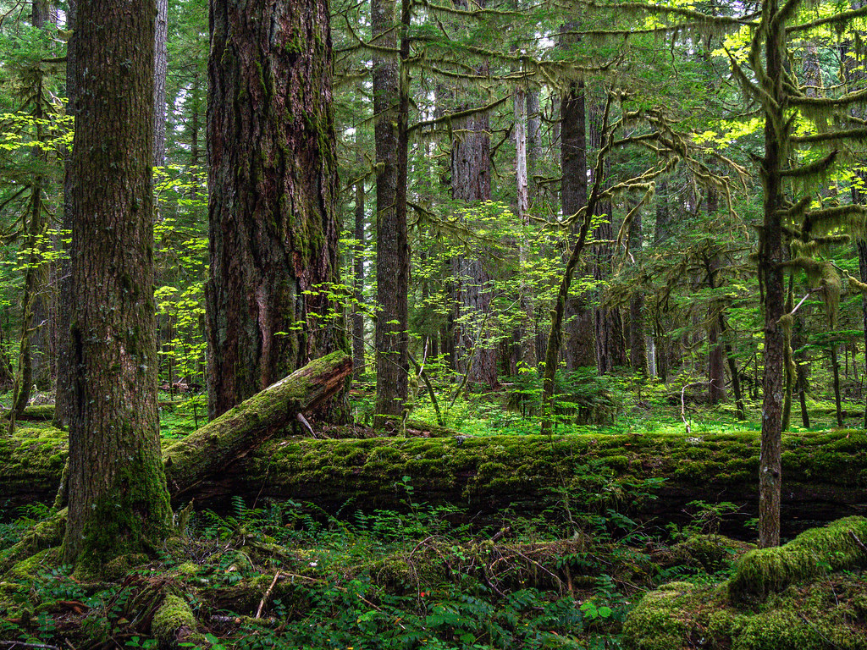
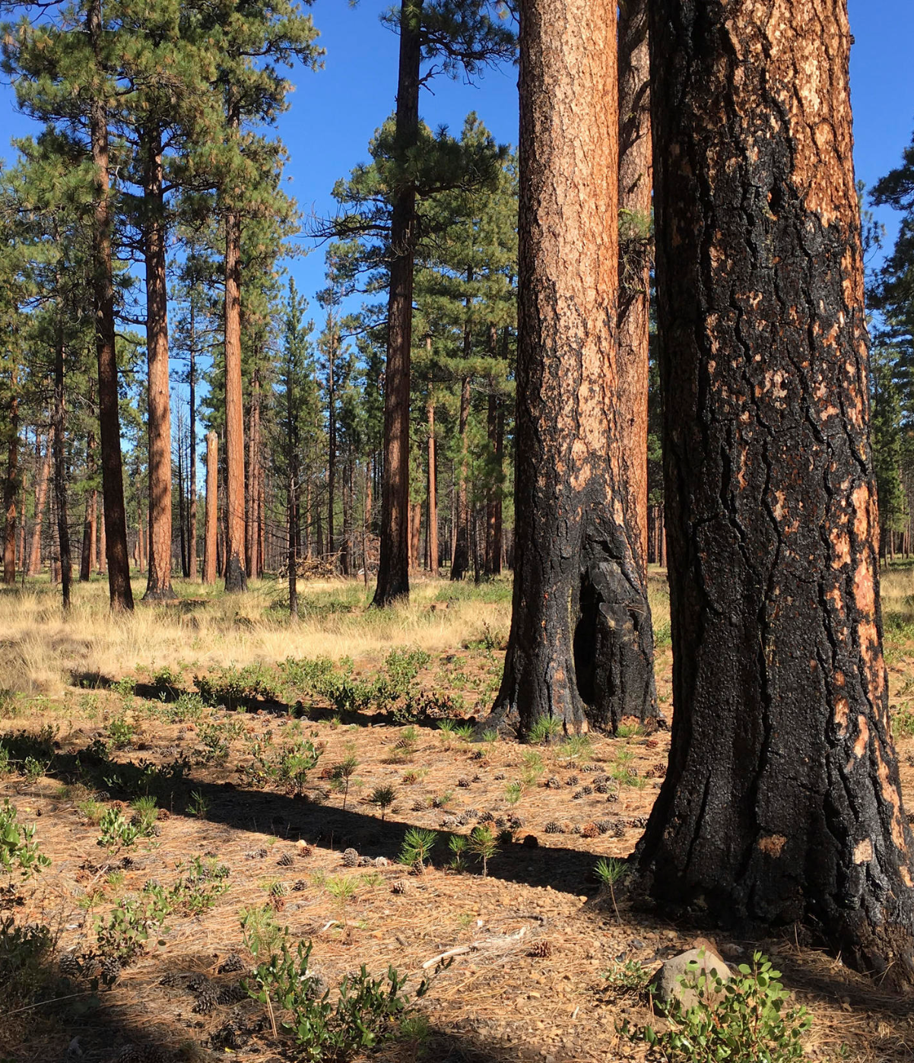
Ecological Context
Western Cascade forest
Eastern Cascade forest
High precipitation
High biomass accumulation
Infrequent, high-severity wildfire
Dry climate
Sparser forest, lower biomass
Frequent, lower-severity wildfire
Notes:
https://www.flickr.com/photos/sigmaeye/49928298063/
http://www.knkx.org/post/fighting-fire-fire-prescribed-burn-training-tackles-forest-health-washington

Slide 4
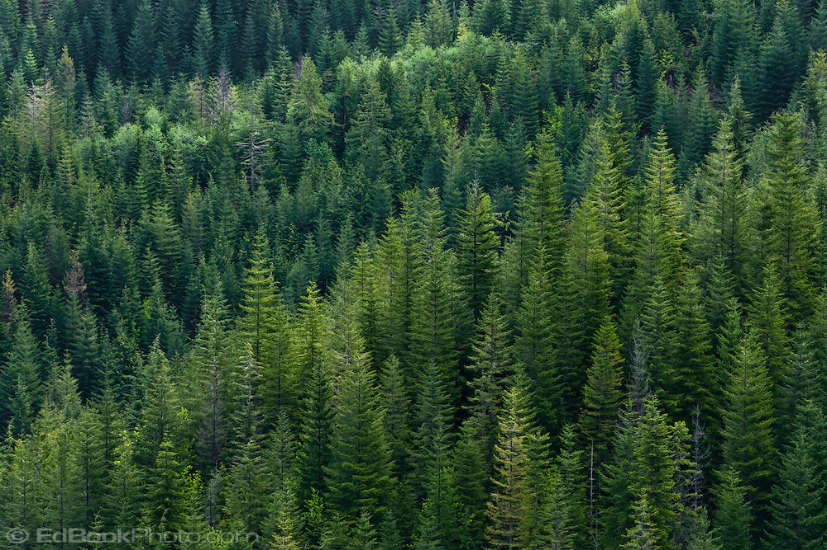
Our Research Questions:
1) Can we create a simple model that qualitatively replicates eastside vs westside fire dynamics?
2) Which parameters are most important for generating these differing dynamics?
Image source
Notes:
Source:

Slide 5
Presentation Roadmap
Ecological Context
Model Description
Experiments + Results
Conclusions
Notes:
H – Ecological context + model description
J – Experiments and Results + conclusions

Slide 6
Model overview
Cellular automata model on 2d grid
Each cell takes on a biomass value
varies between 0 and its carrying capacity
Alternate between growth season and fire season for n years
usually takes around 500 for dynamics stabilize
Growth season: Vegetation increases in biomass and propagates to new cells
Fire season: Fires ignite, spread and burn out

Slide 7
Model Setup
Cellular automata model on a 2-D grid
Fixed boundary conditions (natural barriers)

Slide 8


Model Setup
Cellular automata model on a 2-D grid
Fixed boundary conditions (natural barriers)
ASH
VEGETATION
Amount of biomass in each cell increases

Slide 9
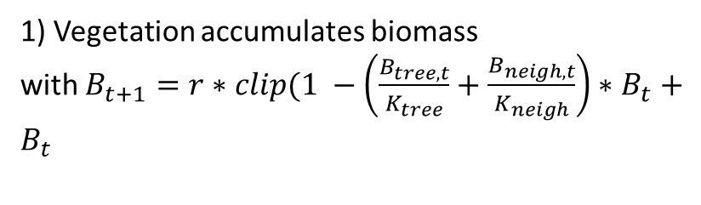
Growth Season
1) Vegetation accumulates biomass
with $B_{t+1}=r∗clip(1 −\left(\frac{B_{tree, t}}{K_{tree}}+\frac{B_{neigh, t}}{K_{neigh}}\right)∗B_{t}+$ $B_{t}$
Before
After
2) Vegetation propagates in neighboring cells
3) Vegetation spontaneously grows in empty cells

Slide 10

Fire season
Before
Ignitions
Ignitions

Slide 11
Presentation Roadmap
Ecological Context
Model Description
Experiments + Results
Conclusions
Notes:
H – Ecological context + model description
J – Experiments and Results + conclusions

Slide 12
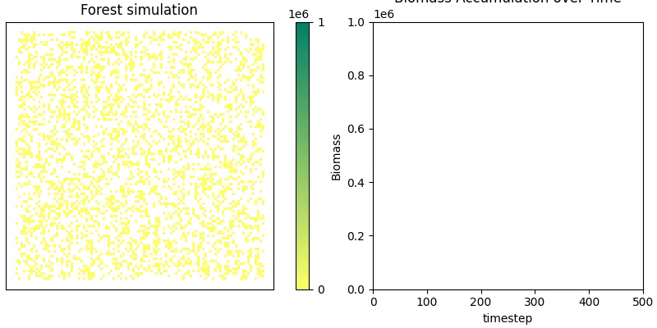
Biomass accumulation over time

Slide 13
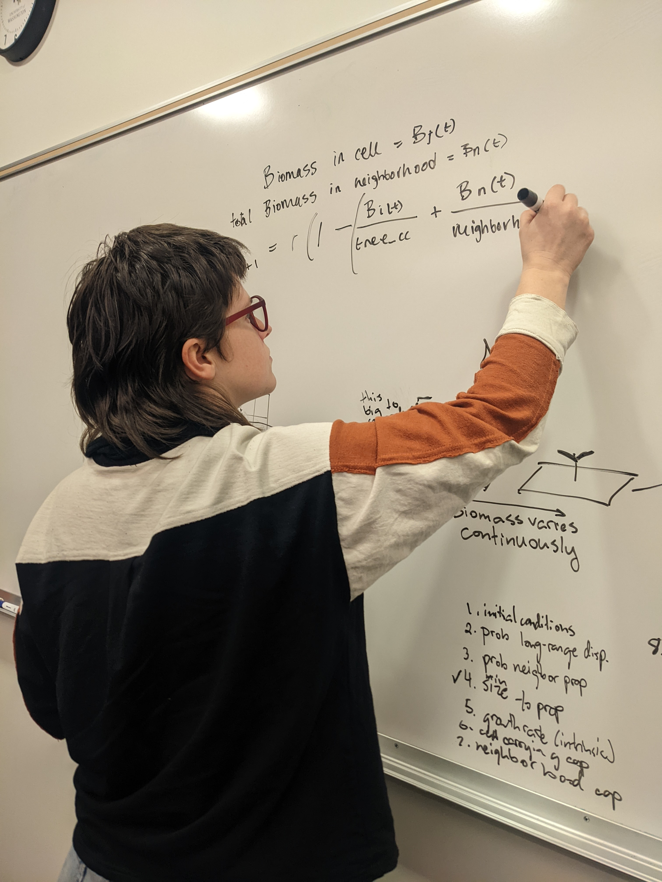
Experiments
2) Eastside vs Westside dynamics
1) Parameter Sweeps

Slide 14
Experiment Set #1: Parameter Sweeps
Vary:
Carrying capacity ratio
Intrinsic growth rate
Carrying capacity
Ignition Probability
Max
Mean
Min
Visual:
Biomass
Parameter value

Slide 15
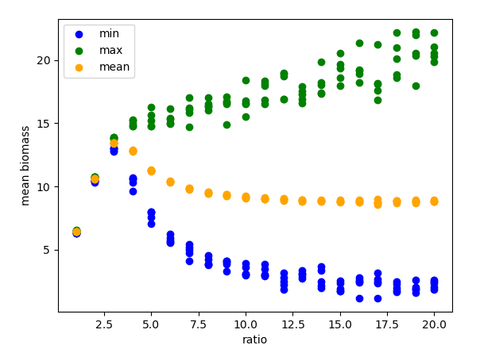
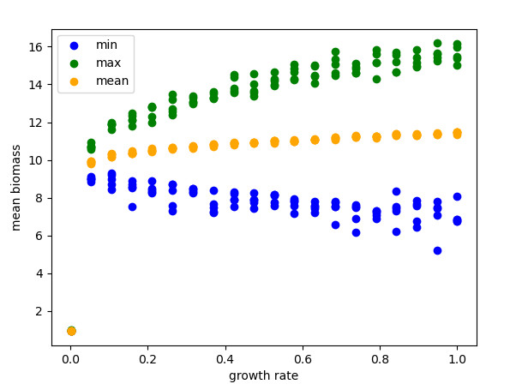
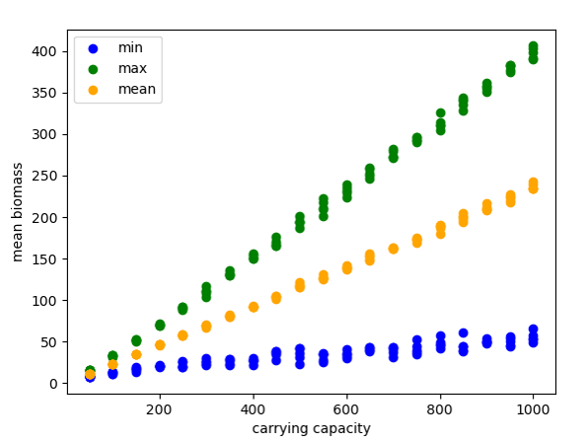
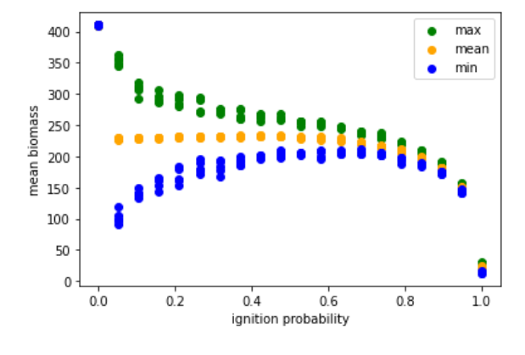
[plots + interpretation]

Slide 16
Experiment Set #2: Eastside vs Westside Dynamics
Vary:
Hand-picked “westside” vs “eastside” parameters
For a characteristic time point:
Over time:
Over time:
Visual:
Biomas
Freq
Freq
Time
Area burned
Patch size

Slide 17
[plots]

Slide 18
Results Discussion

Slide 19
Presentation Roadmap
Ecological Context
Model Description
Experiments + Results
Conclusions
Notes:
H – Ecological context + model description
J – Experiments and Results + conclusions

Slide 20
Conclusions
Our model is fine
Main parameters that seem to drive diff dynamics are: ratio,
[more stuff]
“Your model is sick. Super sick man!” – Brooke Nelson

Slide 21
Avenues for future research
Linear relationship bt source size and probability of fire spreading caused semi-unrealistic dynamics
Tiny little grass fires almost never propagate bc of how we generate burn probabilities:
More realistic would maybe be to have a non-linear relationship

Slide 22
Experiment Set #1
Varying ratio of tree_CC / neighborhood_CC
Varied from 1-20
Made a cool plot of mean, max, min biomass
Found: when ratio < 3, do not see oscillations in biomass; when ratio >3, we do (and amplitude of oscillations increases with ratio)
HOWEVER, mean biomass does not continue increasing after ratio >3

Slide 23
Experiment #2
(choose CCratio to be 5)
Varying intrinsic rate of growth between (almost) 0 and 1
Result: no qualitative change to mean/min/max biomass dynamics over time, but oscillations in biomass got larger with higher growth rate

Slide 24
Thank you!

Slide 25
Questions?

